Slide 1

Case study
of
Underground Substation
Date : 23rd Feb 2023

Slide 2
Introduction To UNDERGROUND SUBStation
Underground electrical substations are generally built in densely populated areas of large and medium-sized cities, with some of the electrical equipment inside the substations using Sulfur Hexafluoride (SF₆ ) gas for insulation. As an ideal insulated gas, SF₆ features excellent properties of insulation and arc extinction. However, SF₆ gas is also a kind of greenhouse gas, and its decomposition products produced under the effect of high temperature and high energy, such as arc, are toxic, and have an impact on human life and safety. Once an accident occurs in the underground substation, there is a hidden risk of leakage in the Emergency Response (ER), which may cause ground air pollution, and endanger personal safety at the same time. Therefore, the recovery and treatment of SF₆ gas and SF₆ decomposition products is highly necessary.

Slide 3


Singapore to Build Underground substation
South-east Asia’s first large-scale underground substation
in Labrador, Singapore

Slide 4
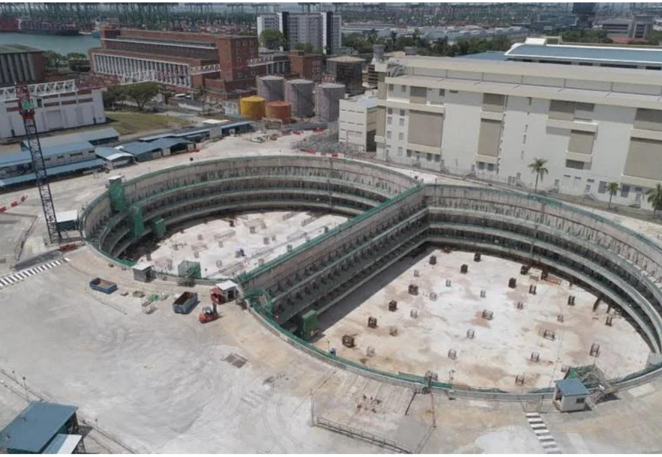

Singapore BuildIng Underground substation
This is South-east Asia’s large-scale underground substation by SP Group is being constructed in Labrador, optimizing space in land-scare Singapore. And it will be spanning some three hectares ( the area of four football fields ).
The land above the underground substation, which will also be Singapore largest 34-storey commercial development.

Slide 5
Singapore Building Underground substation
Given the hidden risk of massive gas leakage in this new 230KV Underground Substation, one of the safety measure taken as an Emergency Response is to cater for a SF₆ Gas Recovery System should such an event occurs. The SF6 Gas Recovery System is to enable the continuous monitoring and control of any SF6 gas leakage from gas insulated transformer rooms and comprises of SF6 gas leakage detection system, SF6 leakage alarm system, gas extraction and storage system.

Slide 6


TGM Global Partnered with HENAN Relations to provide solution
Given that this is the first new underground substation within Southeast Asia, TGM Global chose to work with Henan Relations Co., Ltd who have similar project experiences in China and specializes in the field of full life cycle management of SF6 gas to provide the SF6 Gas Recovery System that meet the requirements of Singapore Power via their sub-contractor, Air Liquide Singapore Pte Ltd.

Slide 7


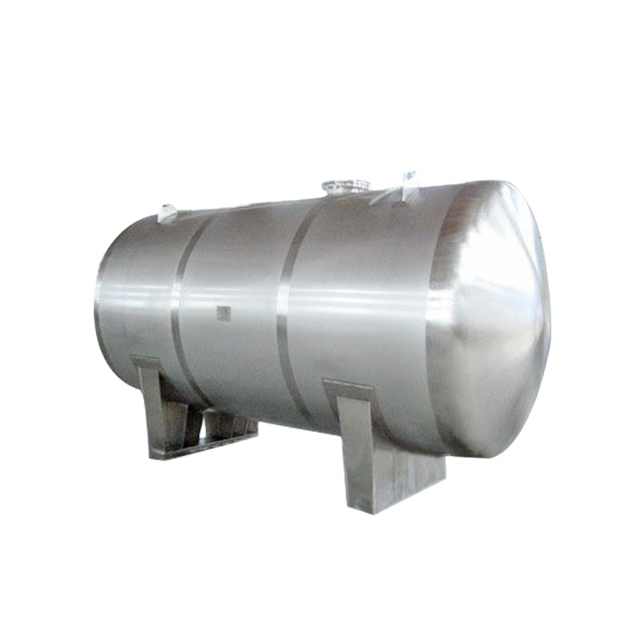
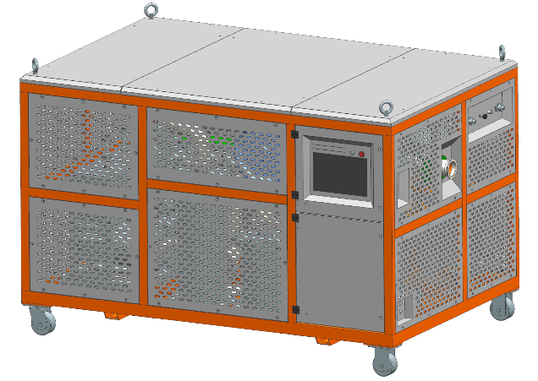
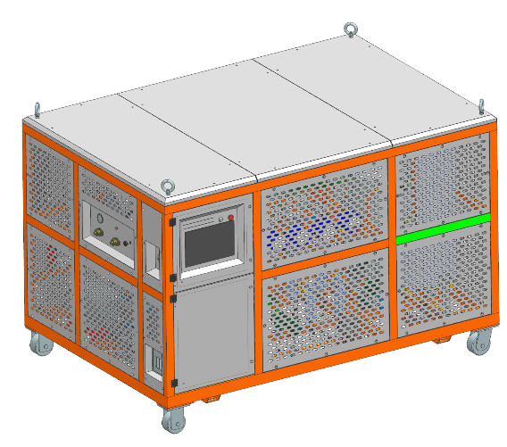
SF6 GAS Recovery SYSTEM
The complete system comprises of :
A) SF6 Gas Leakage and Alarm System consisting of :
(1) Oxygen (O2) gas sensor 12 sets
(2) Sulfur Hexafluoride (SF6) gas sensor 96 sets
(3) Gas Controller with Beacon and Sounder 12 sets
B) SF6 Gas Extraction and Storage System consisting of :
(1) Pipe fan 96 sets
(2) Electric butterfly valve 12 sets
(3) Toxic and harmful gas pretreatment module 1 unit
(4) Energy and maintenance module 1 unit
(5) Storage tanks 4 units
Beacon and Sounder
Gas Controller
SF6 Gas Sensor
O2 Gas Sensor
Storage Tank
Electric Butterfly Valve
Pipe Fan
Pretreatment Module
Energy Module

Slide 8
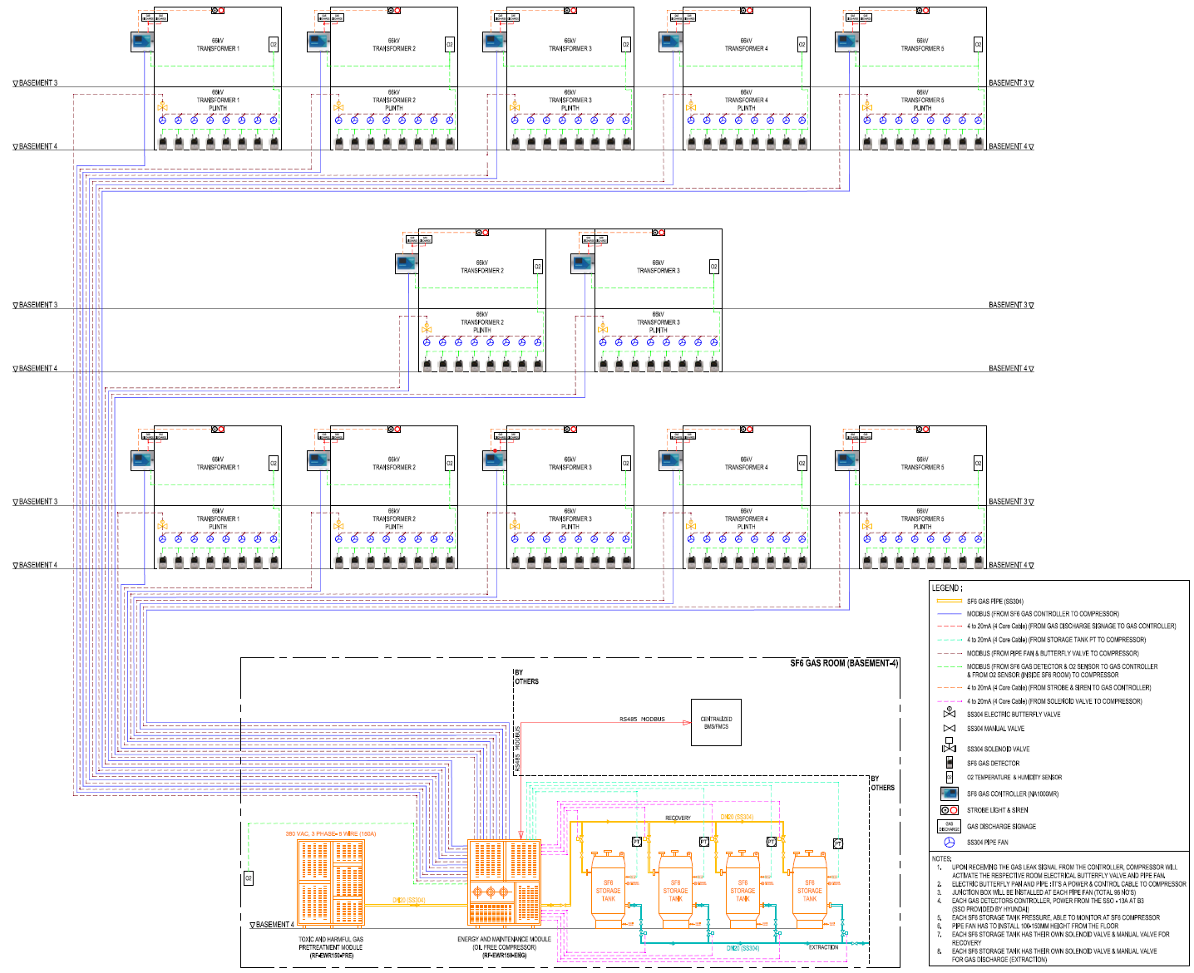
SF6 GAS Recovery SYSTEM
System Configuration Layout

Slide 9
SF6 GAS Recovery SYSTEM
System functionality of SF6 Gas Leakage and Alarm System
The purpose is to monitor the leakage of the SF6 gas in each of the Gas Insulated Transformer (GIT) Compartment and send a warning signal in the event of a SF6 gas leakage
In the event of SF6 gas leakage, the 8sets of SF6 gas sensors which is used for monitoring, will detect and send the SF6 gas concentration level via RS485 to Gas Controller, which in turn is connected to the Centralized PC located in the Pretreatment module.
When the concentration level of SF6 gas reaches the safety level for working personnel as specified in IEC 62217-4-2013, the Gas Controller will send signal via the beacon and sounder to warn all workers and personnel within the GIT compartment to evacuate and gives the signal to Gas Extraction System to activate the compressor to extract the leakage gas to storage system. The Building Management System will also receive the warning signal from Centralized PC.
The Oxygen gas sensor function as a safety monitor and check for working personnel during normal operation and, more importantly, after the completion of gas leak extraction before resumption of work within the GIT compartment.

Slide 10
SF6 GAS Recovery SYSTEM
System functionality of SF6 Gas Extraction and Storage System
The purpose is to extract the leakage of the SF6 gas within the Gas Insulated Transformer (GIT) Compartment where SF6 gas leakage occurs into the storage tanks.
In each Gas Insulated Transformer (GIT) Compartment, 8sets of pipe fan and a piece of electric butterfly valve are installed and they will be activated together with the Pretreatment and Energy module by the Centralized PC to extract the SF6 leakage gas within the GIT compartment.
In the event of SF6 gas leakage, the Pretreatment and Energy module will start automatically and collect the leakage gas and air via the pipe fan into pipes, passes through the electric butterfly into the modules before storing into the storage tanks. While passing through the modules, the humidity, impurities, metal flocs, dust and decomposition are removed from the mixture of air and SF6 gas. Before the air is separated from SF6 gas and SF6 gas is then stored into the storage tanks.
When the SF6 gas concentration level within the GIT compartment lowers to a safety setpoint threshold, the pipe fans will automatically stop and the Centralized PC will provide a signal to the Building Management System to turn on the ventilation to supplement oxygen intake into GIT compartment.
When the storage tank is full, the SF6 gas will be extracted either as a waste gas or recycling for reuse.

Slide 11
Summary
Any underground electrical substations with some of the electrical equipment inside the substations using Sulfur Hexafluoride (SF₆ ) gas for insulation , there will be a hidden risk of leakage of SF6 gas which may cause ground air pollution and endanger personal safety at the same time.
The Emergency Response is to cater for a SF₆ Gas Recovery System should such an event occurs.
A complete SF₆ Gas Recovery System comprises of SF6 Gas Leakage and Alarm System, SF6 Gas Extraction and Storage System.
TGM Global has the experience to build such gas recovery system with Henan Relations equipment.

Slide 12
Thank YOU !!!

